Slide 1
ANTENNA & PROPAGATION
Cap.1

Slide 2
WE FOCUSE ON
Maxwell Equations
Radiation Fields
Transmitting and Receiving Antennas
Linear and Loop Antennas
Aperture Antennas
Antenna Arrays
Coupled Antennas

Slide 3
MAXWELL EQUATIONS

Slide 4
WE FOCUSE ON
Maxwell Equations
Radiation Fields
Transmitting and Receiving Antennas
Linear and Loop Antennas
Aperture Antennas
Antenna Arrays
Coupled Antennas

Slide 5
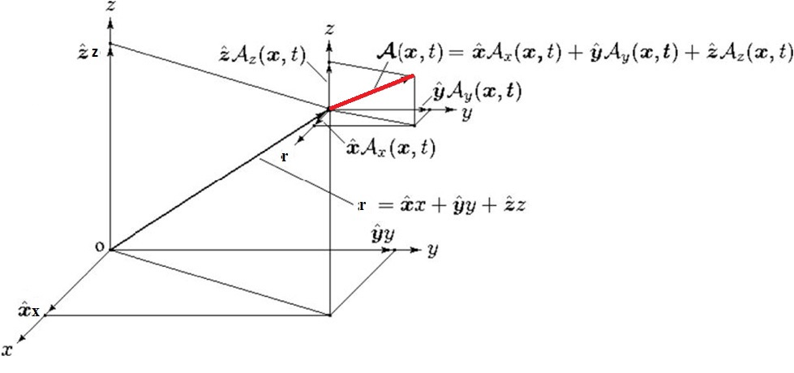
Position Vector and vectorial function

Slide 6
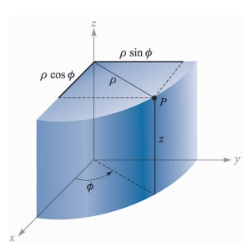
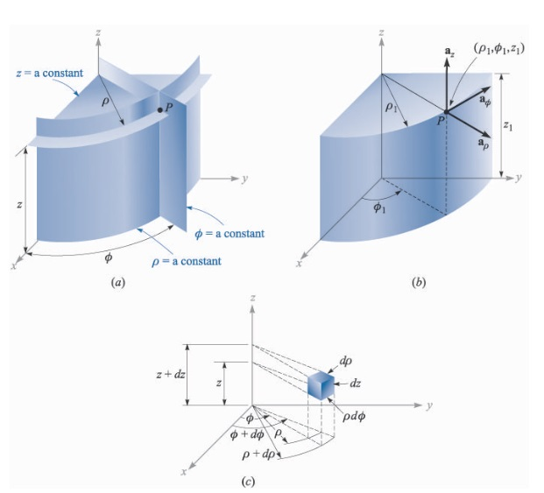
Cylindrical coordinates system

Slide 7
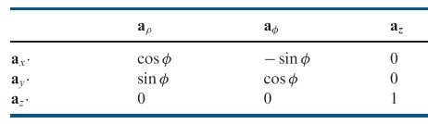
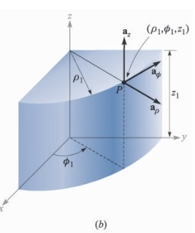
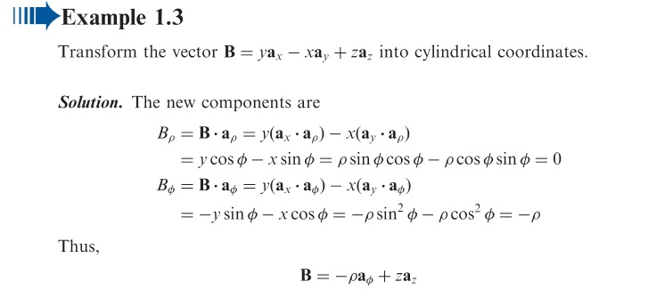
Example

Slide 8
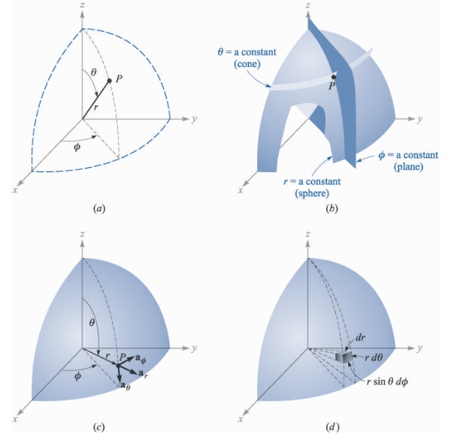
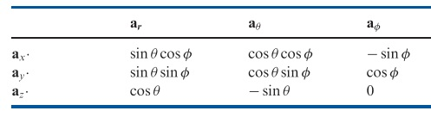
Spherical coordinates system

Slide 9
The divergence
Notes:
There are two main indicators of the manner in which a vector field changes from point to point throughout space. The first of these is divergence, the second is curl.
When the divergence of a vector field is nonzero, that region is said to contain sources or sinks, sources when divergence is positive, sinks when negative. Thus, in a region which contains positive charges , the divergence of the electric induction D will be positive. A similar correspondence exists between negative divergence, sinks and negative electric charge.
The divergence od the vector A at the point P is defined in Eq.(1), where the integration is over the surface of an infinitesimal volume ΔV that shrinks to point P.

Slide 10
Gauss Law

Slide 11
Nabla operator:

Slide 12
EXAMPLE

Slide 13
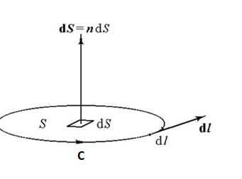
The curl:
Notes:
The point P lies in a plane area bouded by a closed curve C. In the integration that define the curl, C is traversed such that the enclosed area is on the left. Then the component of the curl of A in the direction an is defined as eq.(1).

Slide 14
Stokes’ Law

Slide 15
The gradient:

Slide 16
Lorentz Force
Notes:
The force on a charge q moving with velocity v in the presence of an electric and magnetic field E, B is called the Lorentz force and is given by the equation 1.
Newton’s equation of motion is the equation 2 ( for non-relativistic speeds)

Slide 17
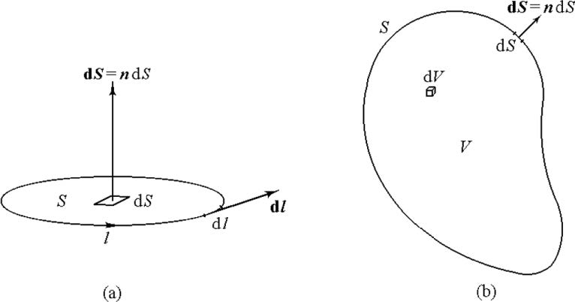
Differential Maxwell’s Equations
-vacuum -
Notes:
E = electric field (V/m)
H = magnetic field (A/m)
B = magnetic induction vector (Wb/m^2) or (T). 1T = 1(Wb/m^2)
D = electric induction vector or electric flux density C/m^2)
ρ = volume density of electric charge (C/m^3)
J = surface density of current (A/m^2)
ε0 = permittivity of vacuum = (1/36π) x 10^(-9) F/m
μ0 = permeability of vacuum = 4π x 10^(-7) H/m

Slide 18
Maxwell’s Equations in material media

Slide 19
Simple media = non-dispersive, linear, isotropic

Slide 20
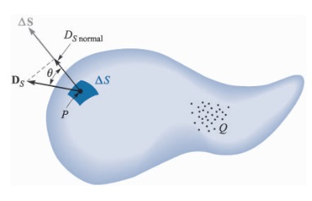
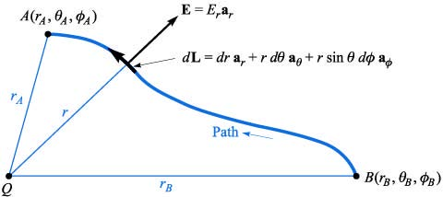
Integral Maxwell’s Equations
Notes:
In the first two equations is used the convention that dl is an infinitesimal vector, tangent to the curve that "surrounds" the vector dS, following the rule of the right drill. In equations 3 and 4, dS represents an infinitesimal vector, always oriented towards the outside of the volume Ω. Σ_{Ω} is the outer surface of the volume Ω.
Equation 5 is the integral form of the charge conservation law.

Slide 21
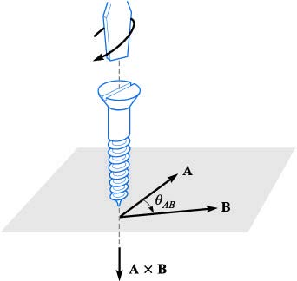
Right-handed screw Rule

Slide 22
Maxwell’s Equations in frequency domain-1
Notes:
A(r) = complex amplitude of an armonic signal A(r,t). It is a vectorial complex function.

Slide 23
Maxwell’s Equations in frequency domain

Slide 24
Source-free media
Notes:
σ<<ωε is the condition for source-free in media with low conductivity and at relatively high frequency.

Slide 25
Dispersive Media

Slide 26
Dispersive Media (2)
Notes:
ωε”E sand σE are terms with the same kind, which describe the dissipation of the medium; the first expresses the dissipation caused by the alternative polarization, i.e. polarization dissipation or dielectric losses, and the second expresses the dissipation caused by conduction current namely Joule’s dissipation. Similarly, ωμ”H expresses the magnetization dissipation or hysteresis loss.

Slide 27
Magnetic currents and charges
Notes:
P. Dirac theoretically argued the existence of magnetic monopoles.
Nevertheless, in applied electromagnetics, to introduce the fictitious magnetic charge and the fictitious magnetic current is beneficial for the analysis of meny engineering problems.
ρm = equivalent magnetic charge density
Jm = equivalent magnetic current density.
Note that the equivalent magnetic current density Jm, the result of the motion of the equivalent magnetic charge, is entirely different from the molecular current density , JM, the electric current due to magnetization.

Slide 28
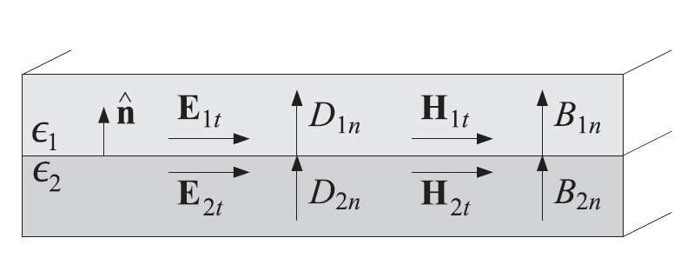
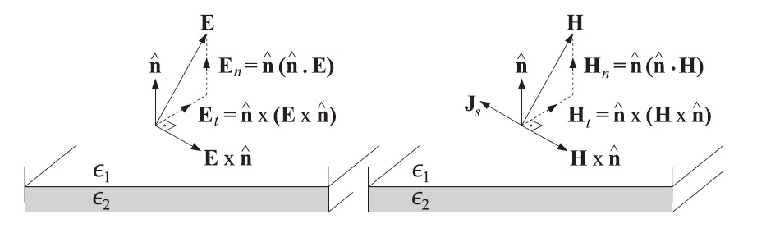
Boundary Conditions
Notes:
The behavior of electromagnetic fields on the boundary or interfaces between media is important in the solution of electromagnetic problems.
In macroscopic theory, the frontier is considered a geometric surface.
Maxwell’s equations in the derivative form are applicable only for the fields that are continuous and differentiable functions. The field functions and their derivatives are discontinuous across the boundary between two media.
On the frontier, the fields must satisfy the conditions on the slide.
n = unit vector normal to the boundary and pointing from medium 1 to medium 2
Js = the surface current density in A/m^2
ρs = the surface charge density in C/m^2.
Jms =the surface equivalent magnetic current density
ρms= the surface equivalent magnetic charge density
Note that only free surface charge and true surface current are included in the ρs and Js, respectively, the bound charge and the molecular current on the surface are not included.

Slide 29
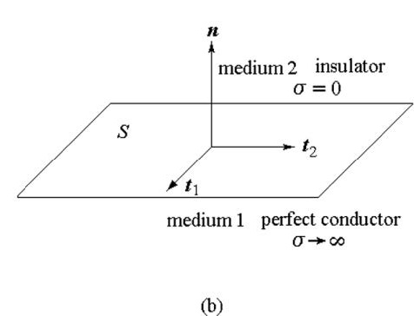
The short-circuit surface
Notes:
In a perfect conductor, the free charges are distributed on the conductor surface so that no electric field is inside the conductor and the electric field outside is normal on the conductor surface. This is the state of electrostatic balance, which does not depend on conductivity, but according to Maxwell’s equations, the time until it reaches this state, called relaxation time, is inversely proportional to the conductivity of the environment. If the conductivity of the medium is sufficiently large and the relaxation time is sufficiently small that the approximate equilibrium is achieved in a negligibly small time compared with the period of our experiment, the medium is considered to be a conductor. On the contrary, if the conductivity is sufficiently small and the relaxation time is sufficiently large that the charges remain approximately motionless within the period of our experiment, it is considered to be an insulator.
For time-varying fields, the conductor also has an electric field and a magnetic field in the form of damped waves. These fields inside the conductor completely disappear only when the conductivity of the material is infinite; in this situation we have a perfect conductor.
If we consider a surface with a normal unitary vector n pointing towards the outside of a perfect conductor, where we have an isolation medium, as in Fig. B, the charges within the conductor are so mobile that the relaxation time is very small and the charges are moving instantly to the conductor surface, concentrating in an infinitely thin layer on the surface of the perfect conductor. This results is a surface charge density ps. The electric field will be null inside the conductor, and outside will be normal to the conductor surface.
According to Maxwell's equations, we can not have a variable magnetic field alone , without an electric field. So inside the conductor we will not have a magnetic field, and the magnetic field outside will have to be tangent to the surface of the conductor.
Conducting currents will flow through an infinitely thin layer from the conductor surface, thus forcing a surface current density, Js, on the surface of the perfect conductor.
In conclusion, the fields in environment 1, the perfect conductor, and in the environment 2, the insulator, will be null.
Any surface on which the tangential component of the electric field is zero and the tangential component of the magnetic field is non-zero, is called an electrical wall or short-circuit surface. The surface of a perfect conductor behaves like an electric wall.
The tangential component of the electric field on the surface of an electric wall is zero, which means that the tangential field component of the electric field satisfies a Dirichlet type condition, and the tangential component of the magnetic field is non-zero.

Slide 30
Open-circuit surface
Notes:
Any surface on which the tangential component of the magnetic field is zero and the tangential component of the electric field is non-zero is called a magnetic wall or open-circuit surface. In this case, there is a magnetic surface charge, ρ_ms and a magnetic current, Jms. The equations on the border are those in the slide.
If we consider the boundary between an environment that is vacuum and a high permittivity dielectric environment, then the surface seen towards vacuum can be approximated by an electric wall, and the surface seen towards the high permittivity dielectric can be approximated by a magnetic wall.

Slide 31
Energy Flux and Energy Conservation
Notes:
The relationship (6) that represents energy conservation law.
The quatity Pd represents the ohmic losses.
The quatity Ps represents the power delivered by the excitations of the fields.
The quantities w and S describing the energy density and the energy flux of the filds are defined as in Eqs. (7) , (8) and (9). The quantities w and S are measured in [J/m^3] si [W/m^3].

Slide 32
Wave Equations
Time-domain Wave Equations
- simple media-
Ecuatii de unda
neomogene
Medii fara excitatii, conductivitate mica, frecventa mare:
Medii fara excitatii, conductivitate mare, frecventa mica:
Ecuatii de difuzie
omogene
Ecuatii de unda
omogene
Notes:
Maxwell’s equations are vector differential equations of first order, which describe the interactions between electric fields and magnetic fields.
The wave equations are derived from Maxwell’s equations, and give the space and time dependence of each field vector. The wave equations are three-dimensional vector partial differential equations of second order.
In homogeneous, non-dispersive, isotropic and linear media, i.e. simple media, ε and μ are constants. Equations 1-2 are the inhomogeneous generalized wave equations. They are time-domain equations. On the right-hand side, ρ and J are the true charge density and the true current density, respectively, which are the sources of the fields. On the left-hand sides, the second-order time derivative terms are oscillating terms or wave terms, and the first-order time-derivative terms are damping terms.
In the source-free region, in a medium with low conductivity, and for fast-time-varying fields, we have the equations 3-4, which are the homogeneous wave equations (3)-(4).
On the contrary, in a medium with large conductivity, and for slow-time-varying fields, the second-order derivative terms can be neglected, and we obtain the diffusion equations (5)-(6). The solutions of diffusion equations are damping or decaying fields rather than waves. They are known as slow-time-varying fields or quasi-stationary fields.
We therefore have two independent equations for the electric field and for the magnetic field; however, E and H are related through Maxwell’s equations.
For a stationary state, the fields are independent of time. The wave equations become Poisson’s equations, and the electric and the magnetic field are completely independent, without interaction.

Slide 33
Wave Equations
Frequency-domain, simple media
Ecuatii de unda
Complexe, neomogene
Notes:
For the sinusoidal time-dependent fields, the wave equations in complex are 1-4.

Slide 34
Solving the Helmholtz equation for guided mode
Mixed problems
Initial values problems
Boundary value problems
Notes:
In the source-free region, they become homogeneous complex wave equations, 5-6, known as Helmholtz’s equations.
In low conductivity media and in the high-frequency range, σ<<ωε, and k^2=ω^2εμ.
The wave equation and the Helmholtz equation are 3D partial vector differential equations. In general there are 3 classes of problems related to these equations:
- Mixed Issues = Issue with Initial and Boundary Values
- Issues of initial values ​​= problem without border values; borders are considered sufficiently remote from the region of interest so their influence can be neglected.
- Problem of values ​​on the border = problem without initial values; the initial time is considered sufficient to depart from the period of interest so that the influence of the initial value may be neglected.
We will look for a general solution to the border problem of three-dimensional and time-variing fields.
The Helmholtz equation can be reduced to the three-dimensional partial-scale equations and then, by an appropriate choice of the coordinate system, they can be reduced to three ordinary one-dimensional differential equations using the method of separation of the variables. These ordinary differential equations, with the imposed border conditions, will eventually be solved; this last step means solving an eigenvalues problem ​​or a Sturn-Liouville type problem.

Slide 35
The vector potential A For An Electric Current Source J
Notes:
The vector potential A is useful in solving for the EM field generated by a given harmonic electric current J. The magnetic flux B is always solenoidal; therefore, it can be represented as the curl of another vector. Thus we define B_{A} and H_{A} , where subscript A indicates the field due to the A potential.
From the vector identity it follows E_{A} . The scalar function represents an arbitrary electric scalar potential which is a function of position, named ø_{e}

Slide 36
Equation for A
Notes:
We have the freedom to define the divergence of A, which is independent of its rotor. This definition is given by the Lorentz condition.
The advantages of solving the vector equation of the waves for A are:
• its rectangular components have as sources the components of the same name of the printed current that shape the field excitation;
• there is no need for zero divergence.

Slide 37
The vector potential F For An Magnetic Current Source M
Notes:
Although magnetic currents appear to be physically unrealizable, equivalent magnetic currents arise when we use the volume or the surface equivalence theorems. The fields generated by a harmonic magnetic current in a homogeneous region, with J = 0 but M≠0, must satisfy div(D) = 0.
Ø_{m} represents an arbitrary magnetic scalar potential which is a function of position.

Slide 38
Equation for F

Slide 39
Electric And Magnetic Fields For Electric (J) And Magnetic (M) Current Sources
1. Specify J and M
2a. Find A (due to J) using
2b. Find F (due to M) using
3. Se calculeaza
4. Cimpurile sunt:
Notes:
In the previous slides we have developed equations that can be used to find the electric and magnetic fields generated by an electric current source J and a magnetic current source M. The procedure requires that the auxiliary potential functions A and F generated, respectively, by J and M are found first. In turn, the corresponding electric and magnetic fields are then determined ( EA, HA due to A and EF, HF due to F). The total fields are than obtained by the superposition of the individual fields due to A and F (J and M).
In summary, the procedure that can be used to find the fields is the one on the slide. R is the distance from any point in the source domain to the observation point where the fields a computed.
We can demonstrate that (1) is a solution of equation in A and (2) is a solution of equation in F. (Exp(-jkR)/R) is the Green function of the equations in A and F. (1) and (2) are the integrals of vector potentials.

Slide 40
Radiation Regions
Notes:
The integration of the vector potential is not computable in the general case. Different approximations may however be established within the phase term Exp(-jkR) of the integral as well as in the amplitude term, 1/R.
Thus, in IEEE 145/1973 standard, the following three areas are defined in the radiated field:
- Near-field region; is the area in the immediate vicinity of the source, where the radiated power of the field is reactive.
- Fresnel’s region;
- Fraunhofer region (far-field zone); in this area, the fields is spherical, and the radiated power is merely active.

Slide 41
Near-Field Region
Notes:
Definition IEEE [IEEE Standard 145]
That region of the field of an antenna between the reactive near-field region and the far-field region wherein radiation fields predominate and wherein the angular field distribution is dependent upon distance from the antenna.
Note 1: If the antenna has a maximum overall dimension which is not large compared to the wavelength, this field region may not exist.
Note 2: For an antenna focused at infinity, the radiating nearfield region is sometimes referred to as th Fresnel region on the basis of analogy to optical terminology.
In this region, the radiated power of the field is dominantly reactive. The field is calculated with the highest possible precision, r₀ being in the order of magnitude of r. This area is defined by the relationship in the slide.
The farthest border of this area is kR = 1.

Slide 42
Fresnel Region
Notes:
Definition [IEEE Standard 145]
The region (or regions) adjacent to the region in which the field of an antenna is focused, i.e., just outside the Fraunhofer region. (See Note 2 of Near-Field Region for a more restricted usage.)
This is the area between the reactive field region and the far-field region, where the radiated power of the field is dominant active, and the angular distribution of the field is R dependent. This area is defined by the relationships in the slide.
In this area, the terms in r of orders 1 and 2 must be retained within the Phase Term exp(-jkR).

Slide 43
Fraunhofer Region (Far-Field region)
Notes:
Definition [IEEE Standard 145]
That region of the field of an antenna where the angular field distribution is essentially independent of the distance from the antenna.
Note 1: If the antenna has a maximum overall dimension D which is large compared to the wavelength, the far-field region is
commonly taken to exist at distances greater than 2D²/λ from the antenna, λ being the wavelength.
Note 2: For an antenna focused at infinity, the far-field region is sometimes referred to as the Fraunhofer region on the basis of
analogy to optical terminology.
In this area, the fields is spherical, and the radiated power is merely active.
In this case, in the phase term, it is necessary to take into account the development of R, only the 1 st term in r.
The integrant does not depend on r. Then we define the Schelkunoff's vector (2).

Slide 44
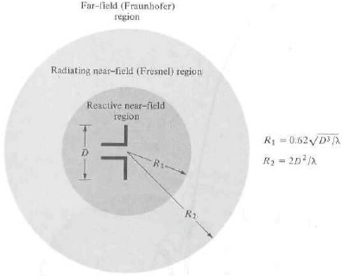
Far-Field Radiation 4
Notes:
The smallest radial distance is 2D²/λ where D is the largest dimension of the radiator.

Slide 45
Example: Infinitesimal Dipole

Slide 46
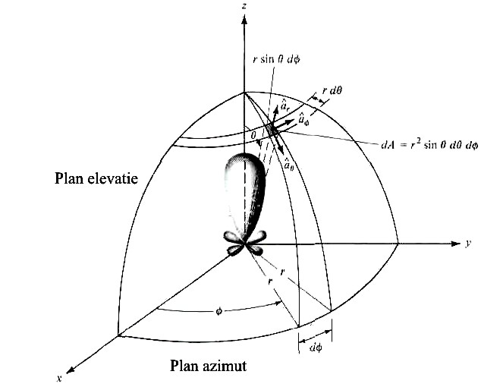
Example: infinitesimal dipole - 2

Slide 47
Example: Infinitesimal dipole - 3

Slide 48
Example: infinitesimal dipole
- Magnetic Field -

Slide 49
Example: infinitesimal dipole
- Electric Field -

Slide 50
Example: infinitesimal dipole
- Electric Field - 2

Slide 51
Example: magnetic current source
Notes:
The fields can be calculated by applying the principle of duality between the magnetic field and the electric field.

Slide 52
Duality Theoreme
Notes:
When two equations that describe the behavior of two different variables are of the same mathematical form, their solutions will also be identical. The variables in the two equations that occupy identical positions are known as dual quatities and a solution of one can be formed by a systematic interchange of simbols to other.
Thus knowing the solutions to one set (i.e. J≠0, M=0), the solution to the other set (J=0, M≠0) can be formed by a propaer interchange of quantities. The dual equations and their dual quatities are listed in next slide for electric and magnetic sources, respectively.

Slide 53
Dual Quantities For Electric (J) and magnetic (M) Current Sources

Slide 54
Radiated Power
Notes:
In the following we will only deal with electrical radiation sources.
The radiated power through a sphere of radius r, with its centre in the origin, is Eq.(1).
Average radiated power is the real part of P_{f}, i.e. the active power is eq.(2).
This power is independent of r and corresponds to the progressive wave that produces radiation. The imaginary part of the relation (2) represents the reactive power corresponding to the stationary wave in the near-field area. The fact that this power is negative shows that there is an excess of electrical power relative to the magnetic power, in the near field (r<=λ/2π).
The ratio between the reactive power and the active power, eq.(3), is independent of the length of the dipole and shows that for (kr <1), ie (r <λ/2π), the reactive power is higher than the active power, which corresponds to the IEEE-145/1973 standard.

Slide 55
Considerations about far and near zones using powers
Notes:
In the remote field, the active power must dominate the reactive power, because a perfectly spherical progressive wave has only active power. For example, if we consider the remote field to start from the moment the active power is at least 30 dB above the reactive one, then we must have the eq.(1).
This way of defining the far zone is much less ambiguous than strictly enforcing the IEEE standard. Thus, the pure spherical wave is obtained when the terms (1/(kr)^2) and (1/(kr)^3) are negligible with respect to (1/(kr)) (which translates into 1/kr<<1). In this case the field is called radiated, eq.(2).

Slide 56
ANNEXA

